Slide 1
[Nonlinear] Dimensionality Reduction
Locally Linear Embedding (LLE)

Slide 2
To avoid the difficulties made by
high dimensional data
Dependencies between
the relevant variables
Separation between
Relevant and
Irrelevant variables
NLDR: Nonlinear Dimensionality Reduction
Linear Methods
Non-linear methods
Sammon’s mapping
Iso-map
Locally Linear Embedding (LLE)
…
Providing a
mapping
ICA
PCA
SVD
…
Just give a
visualisation

Slide 3
LLE
Computes low dimensional, neighbourhood preserving embeddings of high dimensional data.
LLE maps its inputs into a single global coordinate system of lower dimensionality
Here we cover:
  LLE Algorithm
  Implementation
    Neighbourhood search
    Constrained least squares fits
    Eigenvalue problem

Slide 4

Algorithm
This algorithm essentially attempts to compute a low dimensional embedding with the property that nearby points in the high dimensional space remain nearby and similarly co-located with respect to one another in the low dimensional space.
Having the data consisting of N real-valued vectors , each of dimensionality D, sampled from an underlying manifold we expect each point and its neighbours to lie on or close to a locally linear patch of the manifold.
So we can characterize the local geometry in the neighbourhood of each data point by linear coefficients that reconstruct the data point from its neighbours. This reconstruction is local in the sense that only neighbours contribute to each reconstruction, and is linear in the sense that reconstructions are confined to linear subspaces ( it is named as LLE)

Slide 5

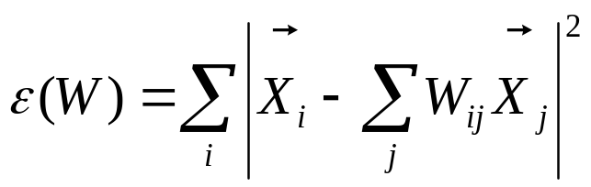
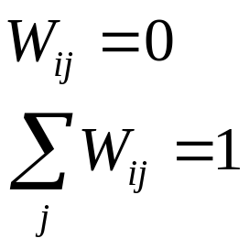

The idea of LLE is to replace each data point with a linear combination of its neighbours. To do so we compute the reconstruction weights by minimizing the bellow cost function:
With two constraints:
  A sparseness constraint: if does not belong to the set of neighbours of
  Invariance constraint:

Slide 6

These constrained weights obey an important symmetry: for any particular data point, they are invariant to rotations, rescalings and translations of that data point and its neighbours the reconstruction weights characterize intrinsic geometric properties of each neighbourhood.
The key idea of LLE consists of assuming that these geometric properties would also be valid for a low-dimensional representation of the data LLE assumes that the data lie on or near a smooth nonlinear manifold of dimensionality and then to a good approximation there exist a linear mapping of the high dimensional coordinates of each neighbourhood to global internal coordinates on the manifold. Through this mapping the would remain the same and reconstruct its embedded manifold coordinates in d dimensions.

Slide 7

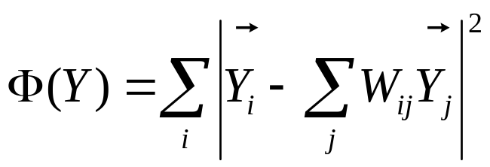
Compute the vectors in the lower dimensional manifold which minimizes the embedding cost function:
  It is again based on locally linear reconstruction error.
This minimization is done subject to constrains that make the problem well-posed.

Slide 8
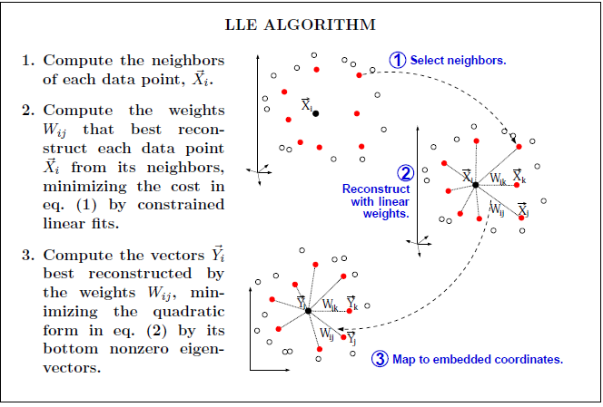

Slide 9


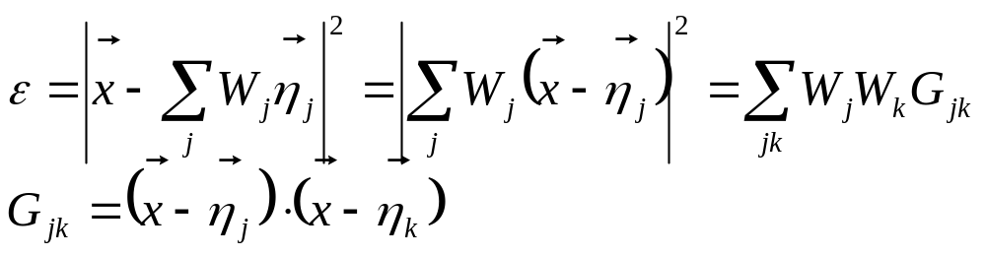
Implementation
It consists of three steps:
Neighbourhood search: one can identify a fixed number of K nearest neighbours per data point as measured by Euclidean distance (for i=1:N we compute the distance from to every other point , find the K smallest distances, assign the corresponding points to be neighbours of .)
Constrained least squares fits: we want to reconstruct each data point from its nearest neighbours.
  For a particular data point :

Slide 10
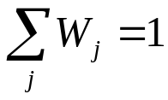
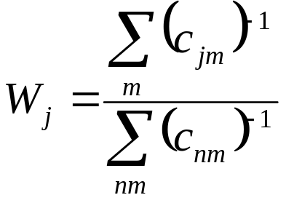
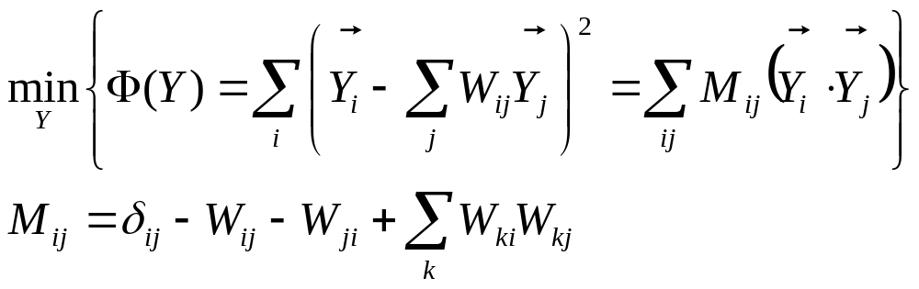
  Using Lagrange Multiplier with the constraint: we can find:
Eigenvalue problem: We have to compute a low dimensional embedding based on the reconstruction weights of the high dimensional inputs. It can be done by:

Slide 11
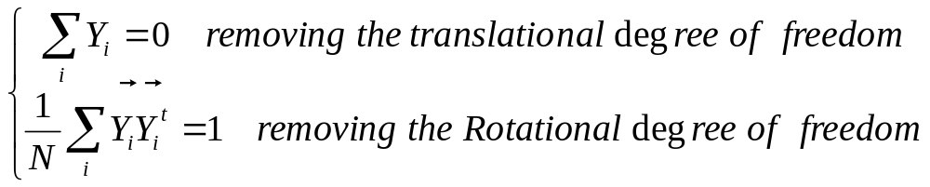
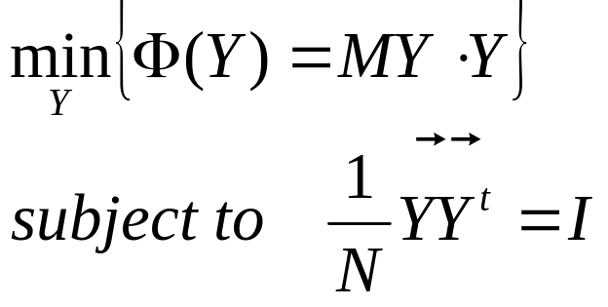
The optimization of the equation is performed subject to constrains that make the problem well posed:
So the problem changes into:

Slide 12
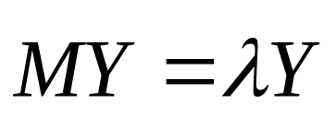
We come down to the eigenvalue problem:
The bottom d+1 eigenvector of the sparse, symmetric matrix M has the smallest d+1 eigenvalues which we discard.
The remaining d eigenvectors constitute the d embedding coordinates found by LLE.

Slide 13
References
Nonlinear Dimensionality Reduction by Locally Linear Embedding, S.T. Roweis and L.K. Saul, Science Vol 290 22 Dec 2000.
An Introduction to Locally Linear embedding, S.T. Roweis and L.K. Saul
Think Globally, Fit Locally: Unsupervised Learning of Nonlinear Manifolds, S.T. Roweis and L.K. Saul, Journal of Machine Learning Research, 4:119–155, June 2003/Technical Report MS CIS-02-18 University of Pennsylvania.
Nonlinear Dimensionality Reduction, Information Science and Statistics, John A. Lee Michel Verleysen, Springer, 2010
Dimensionality Reduction: A Comparative Review L.J.P. van der Maaten , E.O. Postma, H.J. van den Herik, 2008

